Slide 1
Wellcome To Ethical Hacking class 2nd Week Day 2nd
Muhammad Bilal

Slide 2
Information Gathering
Data Scraping Techniques
Google Dorks and Advanced Search Queries
Geolocation and IP Tracing
Social Engineering for Information Gathering Algorithms
Gathering Information on Mobile Apps

Slide 3
Data Scraping Techniques
Overview:
Data scraping involves extracting information from websites. It's a valuable skill for gathering data from public sources.
Techniques and Tools:
HTML Parsing: Using libraries like BeautifulSoup (Python) to parse HTML and extract data.
Web Scraping Tools:Tools like Scrapy (Python), Selenium (for browser automation), and Octoparse (no coding required).
APIs: (Application Programming Interfaces--APIs are sets of rules and protocols that enable different systems to communicate, share data, and integrate functionalities.)Leveraging public APIs provided by websites for structured data retrieval.

Slide 4
Data Scraping Techniques
Headless Browsers:
Using browsers like Puppeteer (JavaScript) to navigate and scrape dynamic content.
Ethical Considerations:
- Ensure compliance with website terms of service.
- Avoid scraping personal or sensitive information without permission.
- Be mindful of the legal implications and potential impacts on website performance.

Slide 5

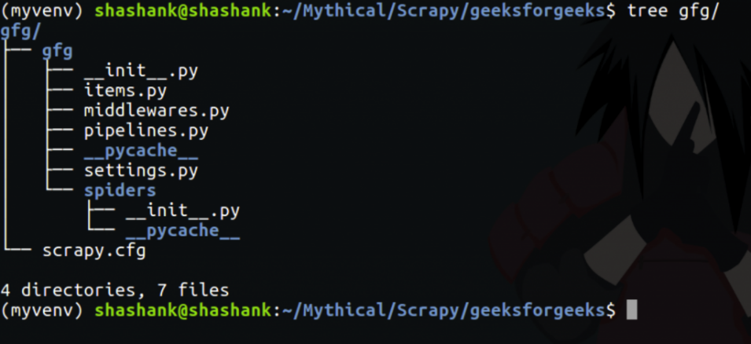
Data Scraping Techniques
URL:
- https://github.com/scrapy/scrapy.
- https://scrapy.org/.
- https://docs.scrapy.org/en/latest/

Slide 6
Google Dorks and Advanced Search Queries
Overview:
Google Dorking (or Google hacking) involves using advanced search operators to find specific information or vulnerabilities on the web.nce.
Key Search Operators:
site: Limits search results to a specific domain (e.g., site:example.com).
filetype: Searches for specific file types (e.g., filetype:pdf).
intitle: Searches for specific words in the title (e.g., intitle:"index of").
inurl: Searches for specific words in the URL (e.g., inurl:admin).

Slide 7
Google Dorks and Advanced Search Queries
Tools:
Google Hacking Database (GHDB): A curated list of search queries that identify sensitive information.
Dorkbot: An open-source tool that automates Google Dorking to find vulnerabilities.
Applications:
Finding exposed documents or files.
Identifying vulnerable web pages or systems.
Gathering competitive intelligence.

Slide 8
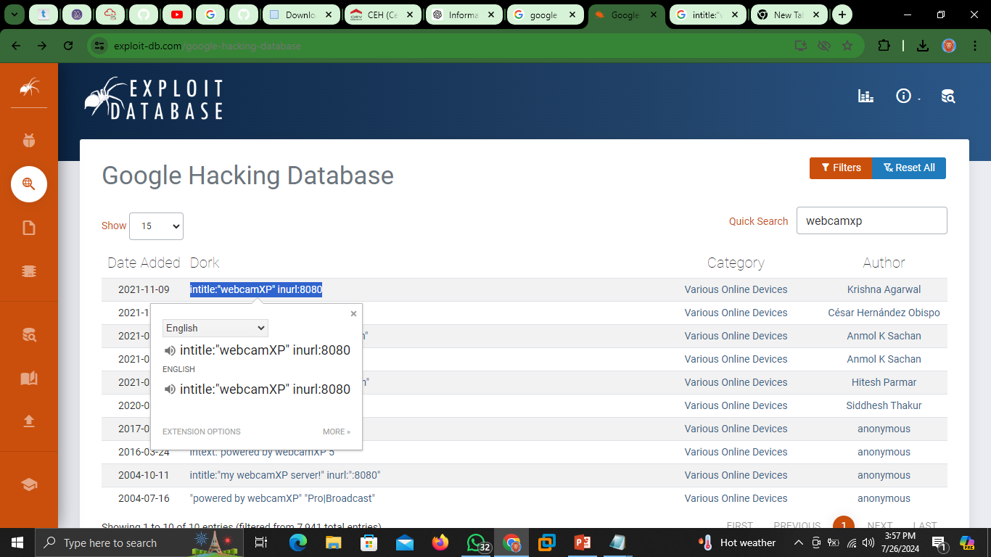
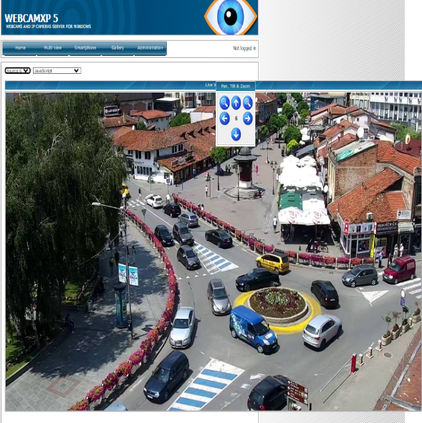
Google Dorks and Advanced Search Queries
URL:
https://www.exploit-db.com/google-hacking-database
https://github.com/chr3st5an/Google-Dorking
https://security.utexas.edu/dorkbot

Slide 9
Geolocation and IP Tracing
Overview:
Geolocation and IP tracing involve determining the physical location of devices or servers based on their IP addresses.
Techniques and Tools:
IP Geolocation Services:
MaxMind GeoIP2: A comprehensive geolocation database.
IP2Location: Another accurate IP geolocation service.
IPinfo: Provides detailed IP address information including location data.
Traceroute:
traceroute (Unix/Linux): A command-line network diagnostic tool.
tracert (Windows): The Windows equivalent of traceroute.
MTR: A network diagnostic tool that combines the functionality of ping and traceroute.

Slide 10
Geolocation and IP Tracing
Wi-Fi and Bluetooth:
Wireshark: A network protocol analyzer for capturing and analyzing network traffic.
Kismet: A network detector, packet sniffer, and intrusion detection system for Wi-Fi.
Use Cases:
Tracking cybercriminals.
Enhancing location-based services.
Conducting network security analysis.

Slide 11
Geolocation and IP Tracing
Tool:
How to run a traceroute on Linux
Type “traceroute” followed by the hostname or IP address you'd like to trace.
Wait for the trace to complete and review the results.
How to run a traceroute on windows
Open a command-line prompt. You can do this by typing “command” from the Start menu, or by pressing the Windows Key+R and typing in “cmd”
From the command-line prompt, type “tracert” followed by the hostname or IP address you'd like to trace to

Slide 12

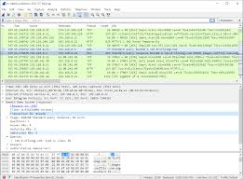
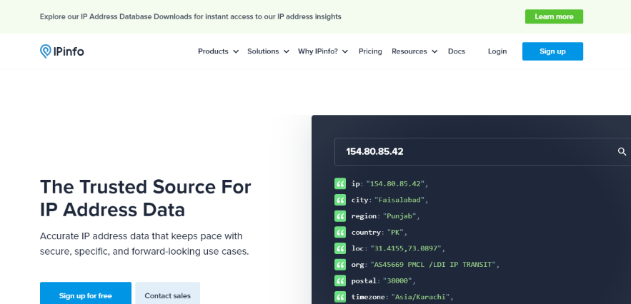
Geolocation and IP Tracing
URL:
https://www.wireshark.org/
https://ipinfo.io/

Slide 13
Social Engineering for Information Gathering Algorithms
Overview:
Social engineering manipulates people into divulging confidential information. It's a common tactic in cyberattacks.
Techniques and Tools:
Phishing:
Gophish: An open-source phishing toolkit.
PhishMe: A comprehensive phishing simulation platform.

Slide 14
Social Engineering for Information Gathering Algorithms
Pretexting:
Social Engineering Toolkit (SET): A Python-driven tool that simulates social engineering attacks.
Baiting:
Honeytokens: Fake digital resources designed to detect unauthorized access.
Tailgating:
Access control systems: Hardware and software solutions for secure entry management.

Slide 15
Social Engineering for Information Gathering Algorithms
Prevention:
Educating employees on recognizing social engineering tactics.
Implementing robust verification procedures.
Using multi-factor authentication (MFA).
URL:
https://github.com/gophish/gophish
https://github.com/trustedsec/social-engineer-toolkit

Slide 16
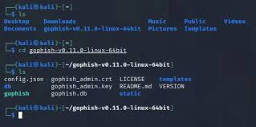
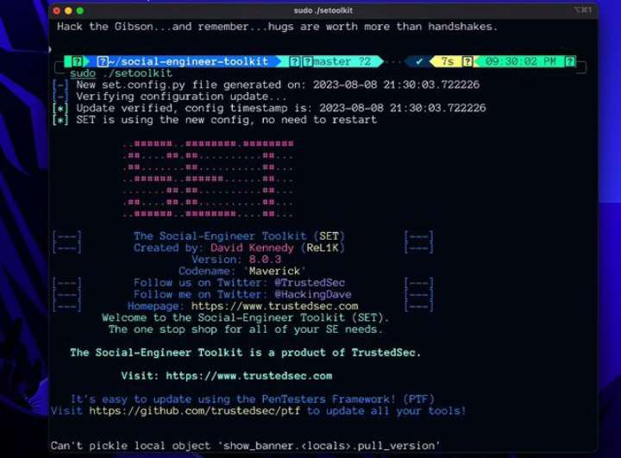
Social Engineering for Information Gathering Algorithms

Slide 17
Gathering Information on Mobile Apps
Overview:
Mobile app analysis involves collecting data about the app's functionality, security, and user privacy.
Techniques:
- Static Analysis: Examining the app's code without executing it. Tools like APKTool or JADX are used for Android apps.
- Dynamic Analysis: Running the app in a controlled environment to observe its behavior. Tools like Frida or Xposed Framework can help.
- Network Traffic Analysis: Monitoring the app's network communication using tools like Wireshark or Burp Suite.
Considerations:
- Assessing data storage and transmission practices.
- Identifying permissions and potential overreach.
- Evaluating third-party libraries and their security implications.

Slide 18
Thank You Happy Hacking

Slide 19


